Slide 1
AdventureWorks: Sales Performance & Growth Analysis
By Pavithra

Slide 2
Problem Statement
Company is struggling to have clear view regarding performance of sales, revenue, and profitability. The organization also lacks clear insight into customer trends. So, an automated app is required to analyze the historical sales data and predict future revenue
Agenda
As a Sales Data Analyst, the objective is to provide directors with a clear and structured view of sales tracking and overall business performance.

Slide 3
Project Objective
Analyze Gross Profit (GPR) and GP% by time, geography, category, and product.
Find patterns customer metrics including customer count, AOV, and customers Behaviors and patterns.
Identify top and products/categories by revenue and orders.
To analyze and determine which individual products generate the highest contribution to total revenue
Decision-makers are not aware of the trends in profit margins.
Analyze the trend of sales growth periods and support data-driven price and business strategy decisions.

Slide 4
Dataset Details – AdventureWorks
Dimension Tables:
Customer Lookup
Product Lookup
Return Data
Product Categories Lookup
Product Subcategories Lookup
Date Lookup – date data type
Territory Lookup
Dataset AdventureWorks Sales Dataset
Total Files: 10 files
File Type: Excel (.xlsx)
Total Tables in Data Model: 7 Tables
Total Records: 30,000–40,000 transactional records
Time Period Covered: 2020 – 2022
Fact Tables: AdventureWorks Sales Data (2020, 2021, 2022)

Slide 5
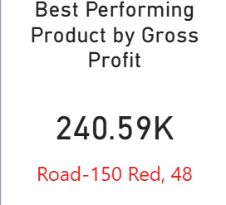
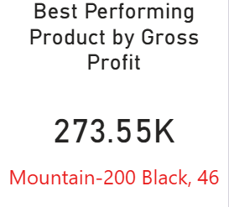
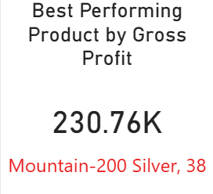
Key KPI Cards
Year - 2020
Year - 2021
Year - 2022

Slide 6
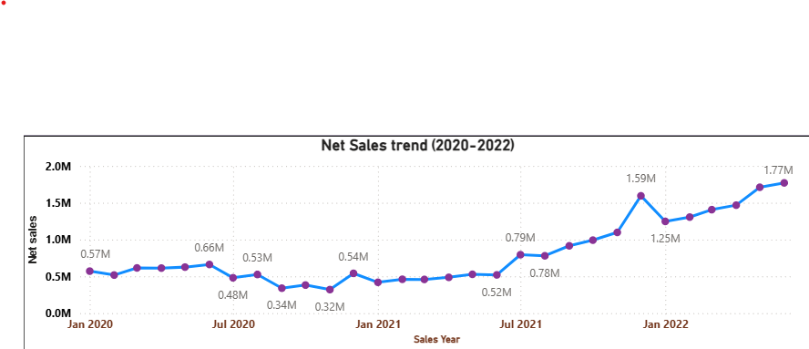
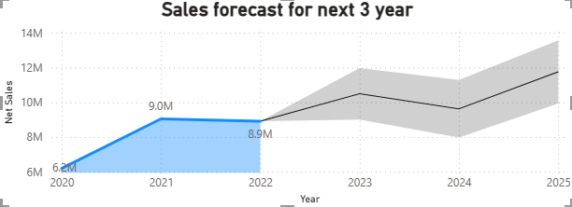
Sales Trends by Day, Month, Quarter & Year and Sales Force
After a decline in mid-2020, net sales showed consistent recovery in 2021 and achieved strong growth in 2022, reaching a high of 1.77M.
Sales are forecasted to stabilize between 10.4M–11.7M from 2023 to 2025, with a temporary seasonal dip to 9.6M in 2024.

Slide 7
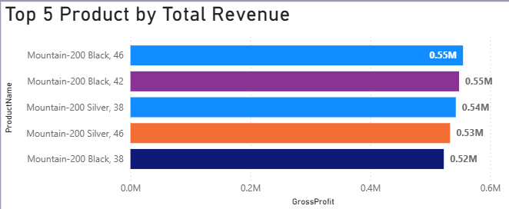
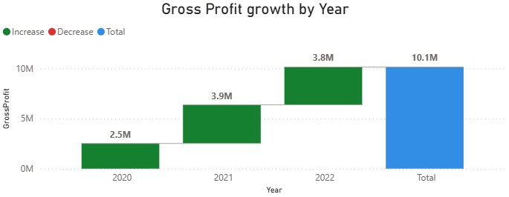
Analysis of top revenue-generating products, profitability comparison, and annual profit growth.
The top three products are Mountain -200 Black (sizes 46 and 42) tied at 0.55M gross profit each, followed by Mountain-200 Silver, 38 at 0.54M
56% increase year over year for profit growth

Slide 8
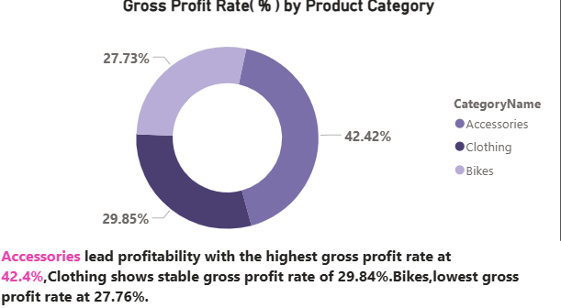
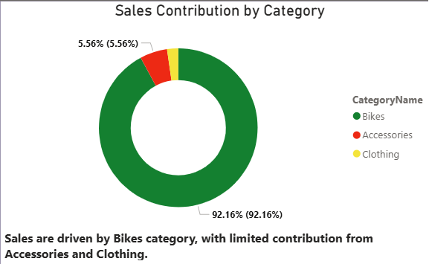
Top Revenue and Volume-Growing Product Types and Categories
Sales are primarily driven by Bikes, while profitability is led by Accessories, which contribute 42.3% of total profit, highlighting a clear difference between sales volume and profit contribution.

Slide 9
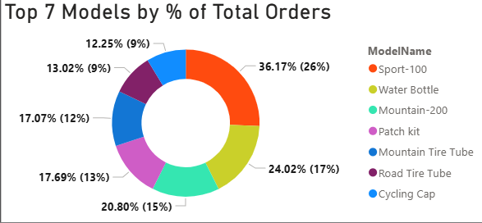
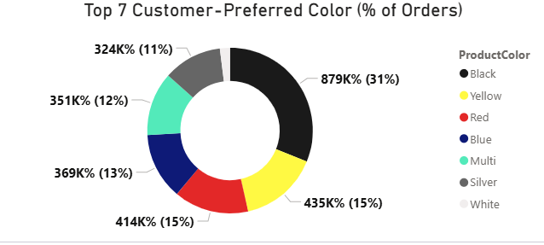
Key Customer Trends in Terms of Purchase Behavior, Colors, and Product Models
Sport100 dominates customer preference with 26% of total orders, followed by Water Bottle and Mountain -200, highlighting demand concentration in a few key models.
Black clearly dominates customer preference with nearly one third of total orders, followed by yellow and red at equal levels of demand.

Slide 10
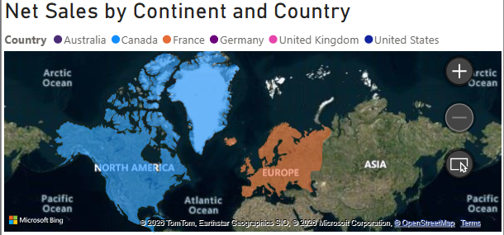
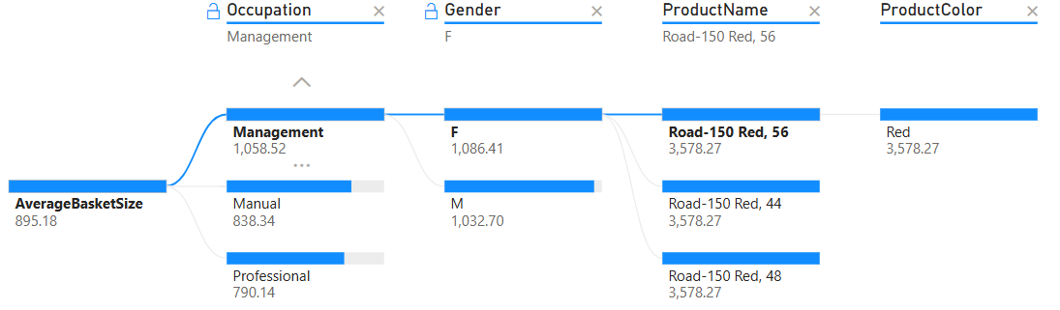
Net Sales Across Regions and AOV by Demographics and Products
North America and Europe show strong net sales at 9.43M and 7.54M respectively, while the Central region records the lowest at 3,143.06. Overall, net sales across regions range from 3,143.06 to 71,76,275.74.
Highlights how average basket size varies by occupation and gender, influenced by product and color preferences, revealing distinct customer buying patterns.

Slide 11
Summary
Net sales peaked in 2022, recording a 168% increase compared to 2020 and a 79% increase over 2021, indicating strong and accelerated business growth.
Based on the three-year forecast, sales are expected to grow significantly, showing an overall increase of 677% from 2022 levels, with sales stabilizing between 12.5M and 15M during 2023–2025.
Total orders spiked from 2.4K in 2020 to 10.9K in 2021, then slightly declined to 8.9K in 2022, indicating demand stabilization after rapid growth.
Mountain products are strong investment opportunities, with Mountain-200 Black (sizes 46 & 42) and Mountain-200 Silver driving the highest gross profit. Consistent demand and positive sales growth support increased investment to maximize future returns.

Slide 12
Summary continued
Sales are driven by Bikes, while Accessories lead profitability, contributing 42.3% of total profit.
Customers show concentrated buying behavior, with Sport100 leading (26%) and Black as the most preferred color, followed by Yellow and Red.
Road-250 Black and Red led 2020 performance, while Mountain-200 Black was the top performer over the three-year period.

Slide 13
Conclusion
Revenue growth can be enhanced by strengthening the Bike segment’s revenue conversion and scaling Accessories and Clothing.
Popular brands like Sport100 and Black should be leveraged to promote additional models and color variants.
Strong performance in North America and Europe provides a foundation for expansion into underperforming regions such as the Pacific.

